Slide 1
Realtime Interview Q&A
Here is where you can find actual Power Automate Q&A

Slide 2
Can you provide an example of how you have used Power Automate to automate a business process and the impact it had on productivity or efficiency?
Automated the employee onboarding process using Power Automate.
Triggered when HR updates the new hire information in SharePoint list.
Automated the creation of user accounts, email setup, and access permissions.
Streamlined document approvals by sending automated notifications to relevant Talent aquation team.
Reduced manual data entry and paperwork, saving time and resources.
Onboarding time reduced by 30%, resulting in faster productivity and integration for new employees.
HR team saved 5 hours per week on administrative tasks, allowing them to focus on more strategic activities.

Slide 3
Can you explain how you would update the existing workflow to include the Microsoft Form uploaded file and fix the issue with the email background?
Modify the workflow trigger to capture Microsoft Form submissions with uploaded files.
Use 'Get response details' action to extract form data, including the file link, and store it in variables.
Implement 'Get file content' action to fetch the uploaded file from the link and attach it to the email.
Adjust email formatting to resolve the background issue, ensuring it displays correctly for recipients.
Thoroughly test the updated workflow with various form scenarios and files to ensure proper execution and file handling.
Document the changes made to the workflow for future reference and collaboration with team members.

Slide 4
Can you explain how you would handle an error or exception that occurs during the execution of a Power Automate workflow?
Utilize the "Configure run after" feature to define specific actions based on the type of error or exception encountered.
Implement "Scope" actions to encapsulate critical steps within a workflow and handle errors separately.
Use "Terminate" actions with appropriate error messages to stop the workflow when necessary.
Employ "Retry" mechanisms to automatically rerun failed actions after a short interval for transient errors.
Set up email notifications or alerts to inform relevant stakeholders about the error occurrence.
Implement "Catch" blocks to handle exceptions and execute recovery actions or log errors for analysis.
Regularly monitor and review error logs to identify recurring issues and optimize the workflow.

Slide 5
Can you explain how you would optimize a Power Automate workflow to improve its performance and efficiency?
Minimize the number of actions by simplifying and optimizing the workflow logic.
Use "Scope" actions to group related steps together and reduce visual clutter.
Utilize parallel branches to perform independent tasks simultaneously, improving overall execution time.
Implement "Configure run after" options to skip unnecessary actions when certain conditions are not met.
Apply "Delay" actions strategically to prevent overloading systems with frequent requests.
Optimize data processing by using appropriate filtering and aggregation techniques.
Use variables to store intermediate results and reduce redundant data retrieval.
Regularly review and refine the workflow to ensure it aligns with changing business requirements and maintains optimal performance.

Slide 6
Can you explain how you would handle authentication and access control in a Power Automate workflow when connecting to external services or systems?
Utilize OAuth or API keys to securely authenticate with external services or systems.
Apply role-based access controls (RBAC) to limit user access and permissions within Power Automate.
Avoid embedding sensitive credentials within the workflow and use secure data connections instead.
Implement Azure Active Directory (Azure AD) for centralized user authentication and management.
Use service accounts or managed identities to access external services, reducing the exposure of user credentials.
Regularly review and update access policies to ensure compliance with security standards and regulations.
Monitor and audit access logs to detect and address any suspicious or unauthorized activities.

Slide 7
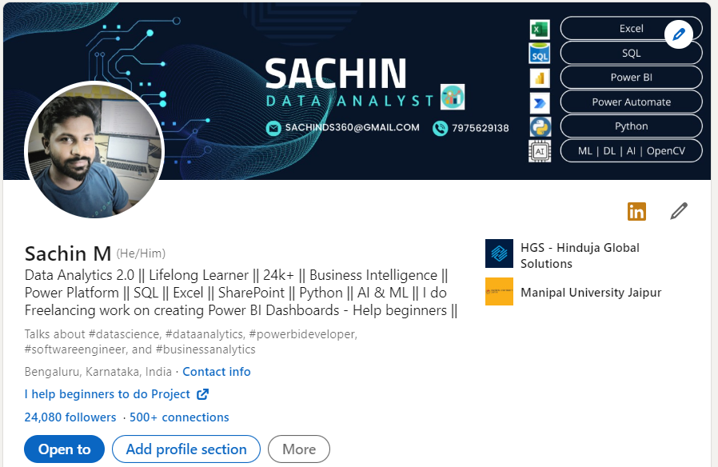
Thank You Connect me on LinkedIn

